Slide 1
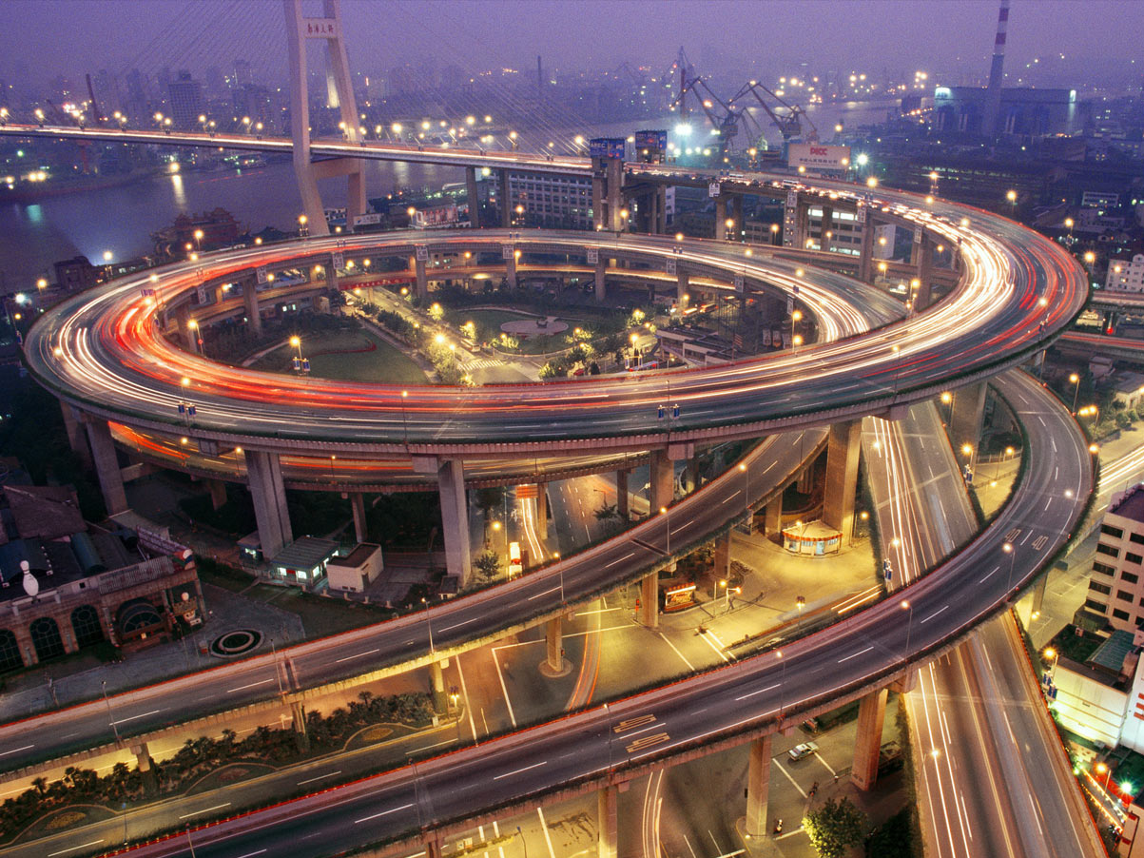
User Experience for
Large-scale Web-Applications
Challenges
Learnings
Design Solutions
Ashutosh Kumar

Slide 2

About me…
- Industrial designer from IIT Mumbai
- Designing User Experiences for 10 years
- Now: Principal Interaction Designer in Yahoo!
- Past: Worked with HumanFactors
Contact: ashutoshk77@yahoo.com

Slide 3
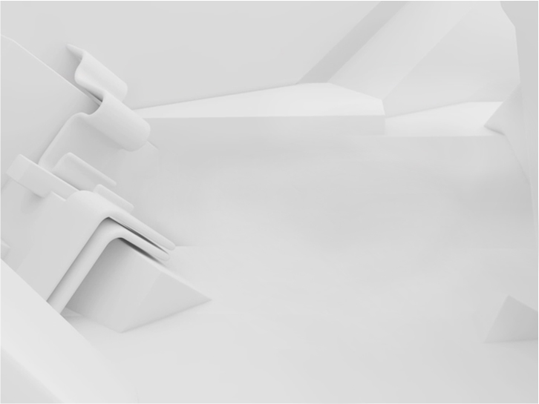
I will talk about…
SDLC
CLDS
challenges
learnings
design solutions

Slide 4

My perspective…
UserXperience
Business
Technology
Development

Slide 5

Why User Experience ?
Technology
Constraints
Business
Needs
User Experience
Functional
Needs

Slide 6


Challenges means…
Things with a sense of difficulty…such as
Unclear understanding of expectations
+
Compromised user experience
+
Stretched development timelines
+
Multiple quality review cycles
=
Increased development cost

Slide 7
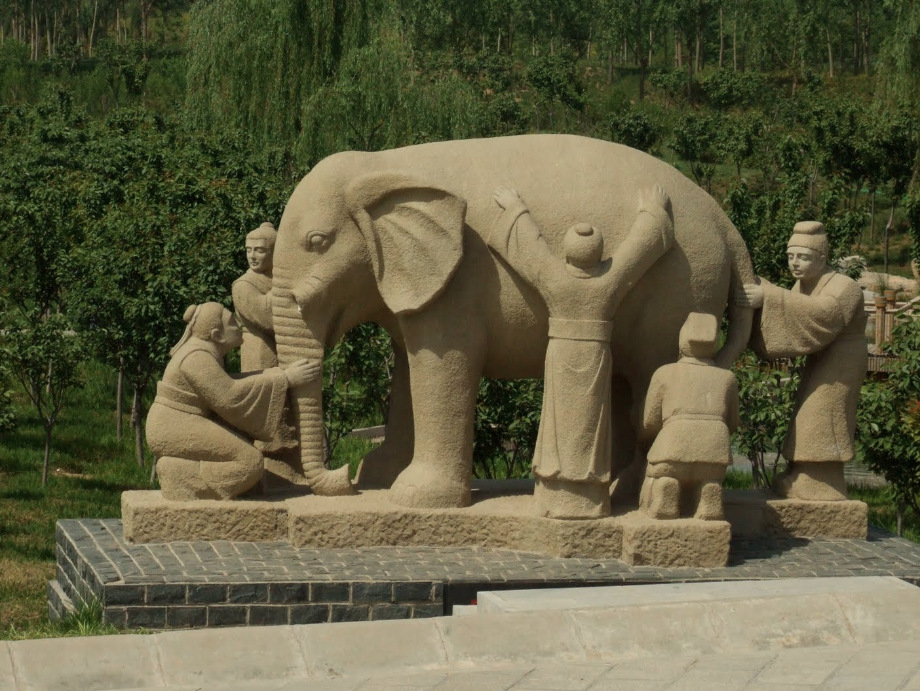
C1
Keeping stakeholders on the same page

Slide 8
L1
Often teams…
Get requirements as LIVE
Receive changing SCOPE (3>5>all browsers)
Focus on own SILOS
Lack understanding of product ECOSYSTEM
Have low understanding of USERS

Slide 9
S1
State the design goal…
Business Needs
Stakeholder Views
Competitive Review
Related Products
User Needs
Data Gathering
1
2
3
Contract for Design
“Defining problem is as important as solution itself”

Slide 10
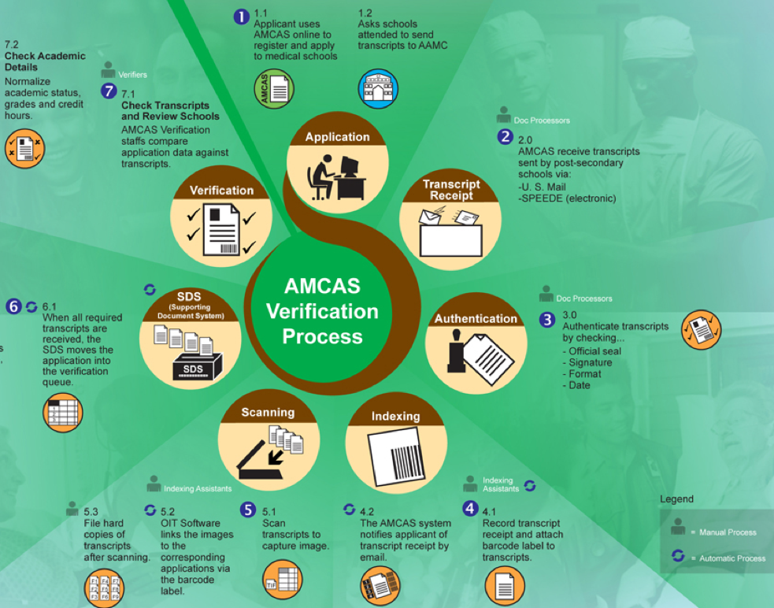
S1
Design the Eco-system…

Slide 11
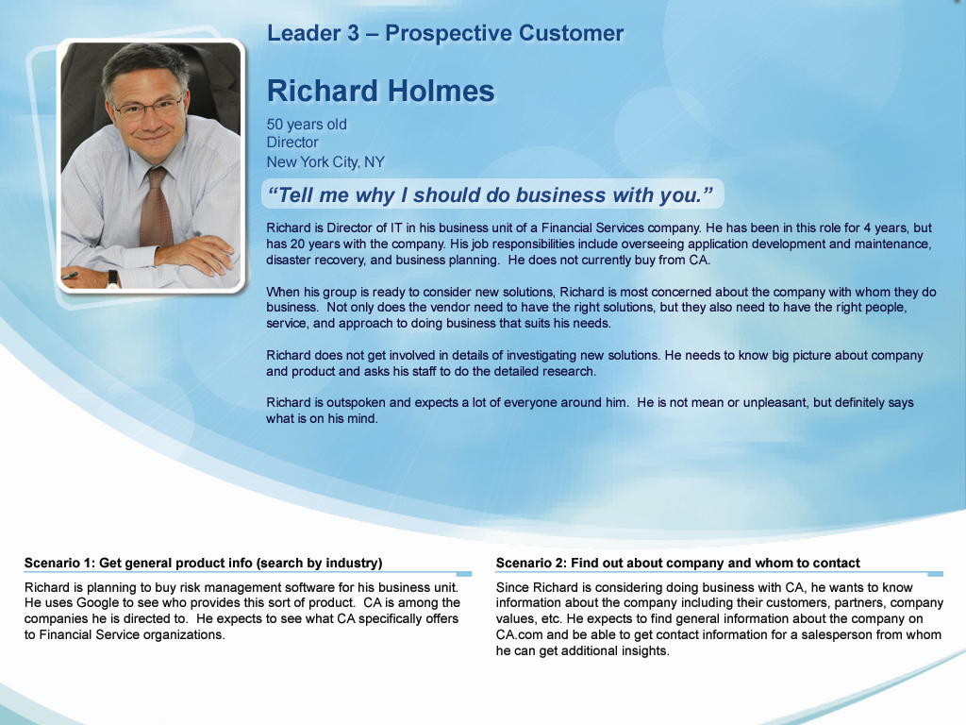
S1
Define your users…

Slide 12

C2
Designing for diverse users

Slide 13
L2
Understanding User Needs…
Identify typical user groups
Write simple user stories (usage scenarios)
Document their KEY tasks (80% vs. 20%)
Optimize Task-flows (beyond current processes)

Slide 14

S2
Understand users…
52 years old
On the job 25+ years
Uses computer 1-2 times per week
Personality Traits: Professor in a PG college, about to retire in 2-3 years. Infrequently uses computer at home to communicate with sons settled in different cities. Key decision maker in extended family vacations to spend quality time in leisure as well as pilgrimage locations.
PC Gupta
Professor
Things I need to know
Things I want to do
Railways tour packages
Detailed Travel Itinerary and route map
Accommodation options
Easy and simple information
Do’s and Don'ts for railway booking process
Associated rules and regulations
Promotional discounts
Choose and tweak standard journey plans
Plan journey stopovers
Compare cost and finalize Travel plan
Book tickets
Seek customer support

Slide 15

S2
Streamline workflow…
App 1
Deal Desk
1. Review Documents
Enter Deal
LMS
App 2
Email
2. Check for signatures
Excel
Signatory Authority
Counter Party
Operations
Agent
Closers
3. Close Deals
Deals: The Task Flow
1
2
3
4
5
View Deals
Identify Deals that are Ready-to-Close
Review Funding Memo
Allocate Funds
Specify individual funds
Handover
to Ops.

Slide 16
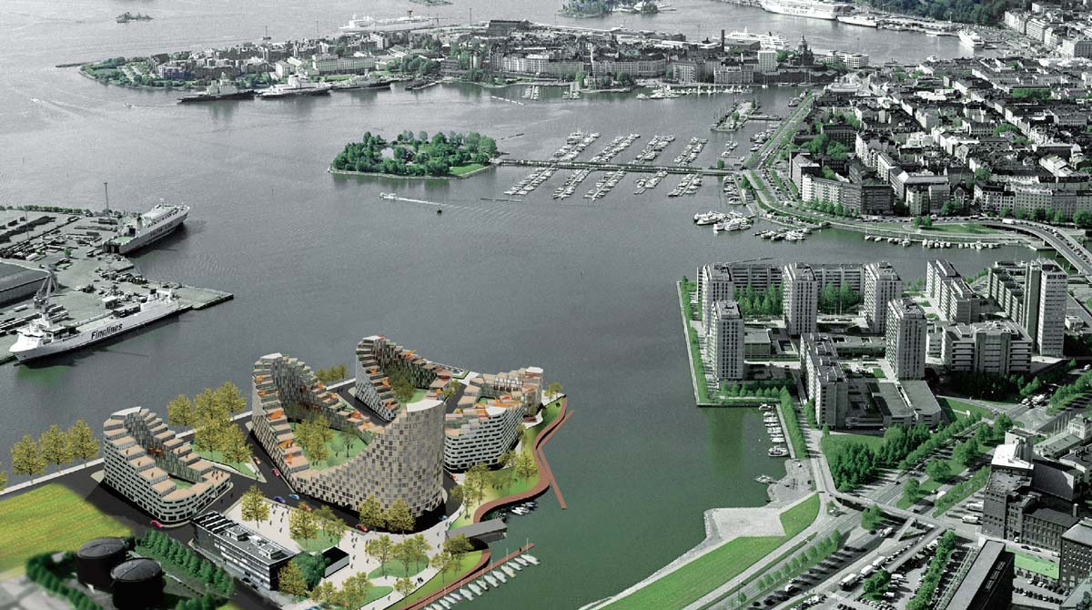
C3
Scalable UI structure

Slide 17
L3
Visualize future roadmap…
Think ahead about future needs
What you need after 3years should start now
Prioritize and follow phased approach
Navigation design and UI containers should grow

Slide 18
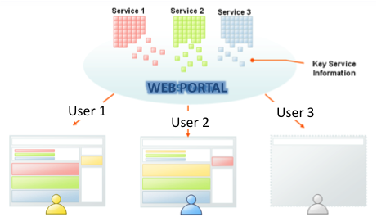
S3
Modular design…

Slide 19
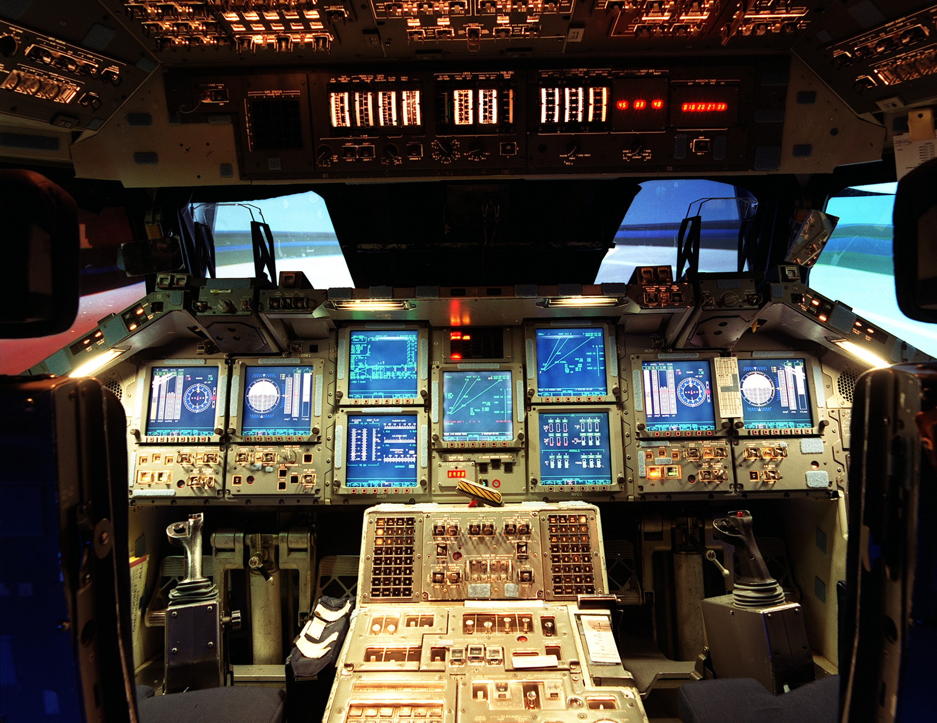
C4
Complex Screens

Slide 20
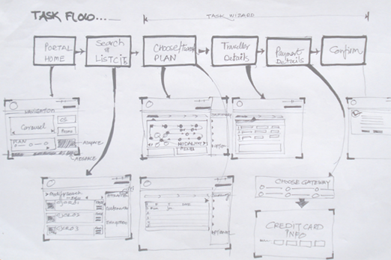
L4
Find what users REALLY need…
User Tasks
Search Travel Plans
Find Trains
Plan Journey Breaks
Define Travelers
Make Payment
User Object Table
User Object | Count | Views | Actions | Attributes
Travelers | 10s | List Summary | Enter Data Login Allocate Seat | Gender Age First Name Last Name Address Contact Phone e-mail Login Password
+
UI Container

Slide 21
S4
Expose UI as needed…
Show what users need NOT what database structure
Use deferred creates
Accordion panels
Show/hide vs. enable/disable
Dual Mode UI (basic and Advanced)
Simple wizards
Educative interfaces (QA format)

Slide 22

C5
Design for Performance

Slide 23
L5
UI is ALSO responsible for Performance
Keep modular and fluid UI containers
Keep nested DIVs as simple as possible
Use CSS Sprite to minimize HTTP requests
Keep CSS and other assets lighter in size
Define and follow CSS nomenclature

Slide 24
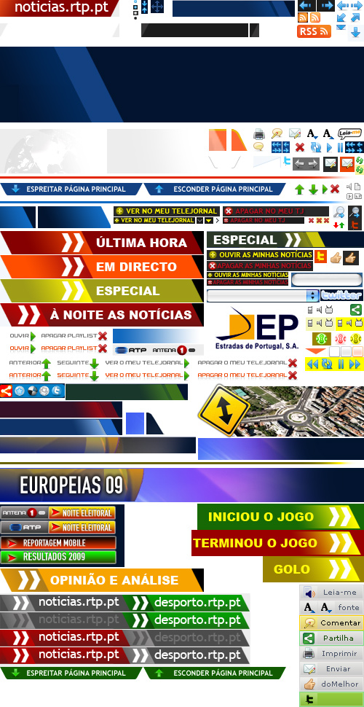
S5
CSS sprites…

Slide 25

C6
Lack of UX Knowledge management

Slide 26
L6
Often development teams…
Care about their own module
Put less priority to UX guidelines
Do not follow UI patterns fully
Hack solutions
Practice what is EASY NOT what is important

Slide 27
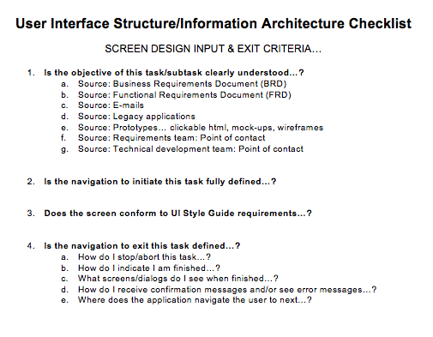
S6
Simple checklists…

Slide 28
S6
Master repository for…
UI wireframes
CSS file and strict version control
Image/sprite library
Best coding practices
UI style guide
UI layout templates
UI controls

Slide 29
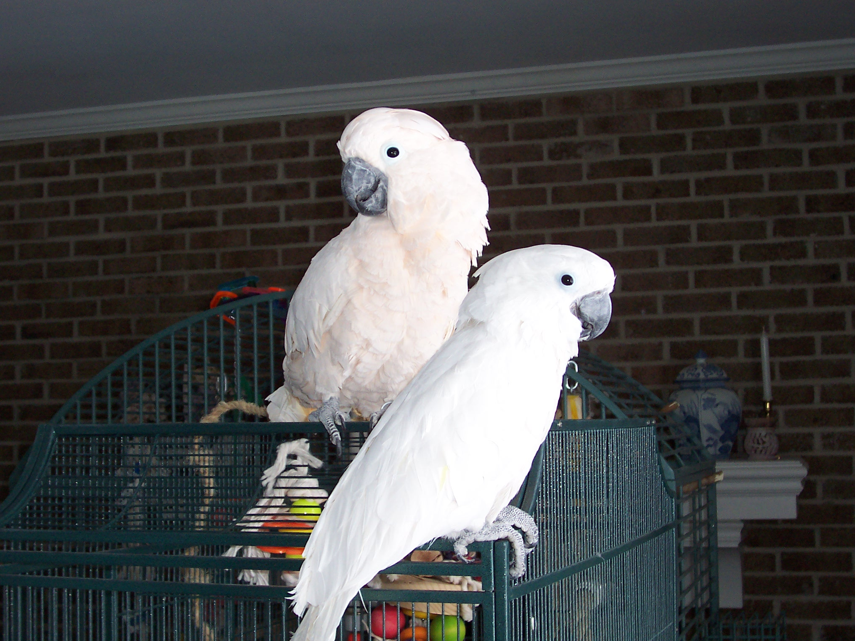
C7
Lack of communication

Slide 30
L7
Development teams…
Re-invent the solutions NOT reuse
Do not share hacked solutions
Deviate from standard practices
Drop features instead of solving them

Slide 31
S7
Set communication channels…
Core team
UX team
UI style guide
Master CSS
Sprite/images
UI layout templates
UI controls
Regular flow
Special requirements
Dev 4
Dev 1
Dev 2
Dev 3

Slide 32
Contact: ashutoshk77@yahoo.com

